Slide 1
Design marketing strategies
for maximizing the Cyclistic members
Created by: Graveo Wicaksana
Last Updated: November 27th, 2022

Slide 2
Table of contents
Background
Data Processing
Analyzes
Recommendations
Notes:
Purpose Statement; Tell Your Story; Conclusion; Appendix

Slide 3
Background

Slide 4
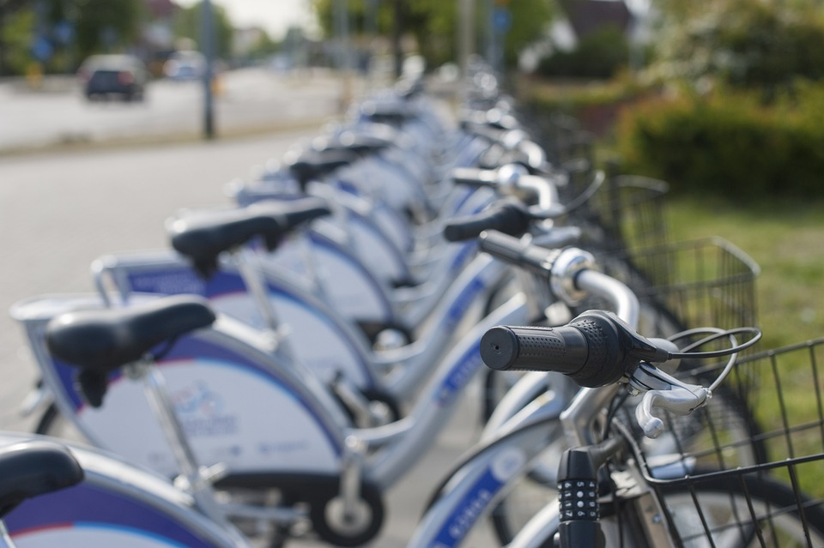
Background
In 2016, Cyclistic launched a bike-share offering
Two consumer segments:
Casual Riders
Annual Members
Annual members are more profitable than casual riders.
Objective: Design marketing strategies aimed at converting casual riders into annual members.

Slide 5
Data Processing

Slide 6
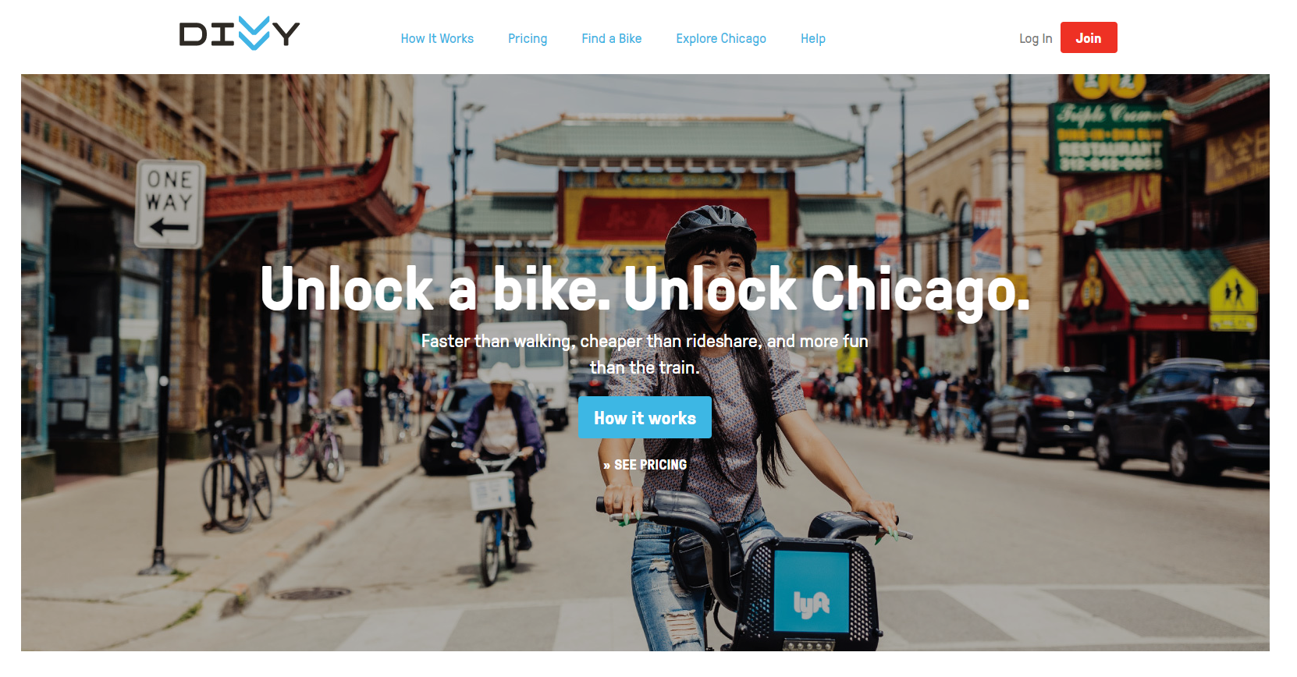
Collection Data
Based on Divvy trip data website
Focused on last the 12 month of trip data

Slide 7

Tidy Up Data
Import the data into R
Give the consistent column name
Clean up the dirty data
Calculate summary data
Export a summary file

Slide 8
Analyzes

Slide 9
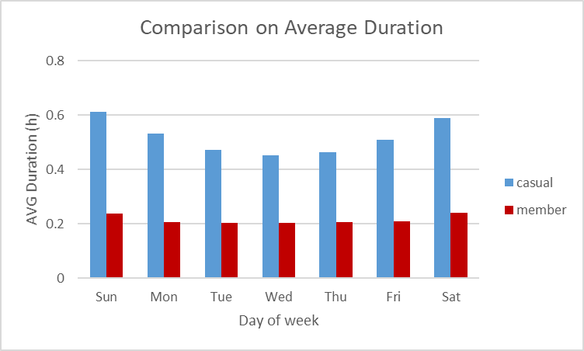
Average Duration
Casual riders do cycling longer
Average duration is increased near weekend
Casual
Member

Slide 10
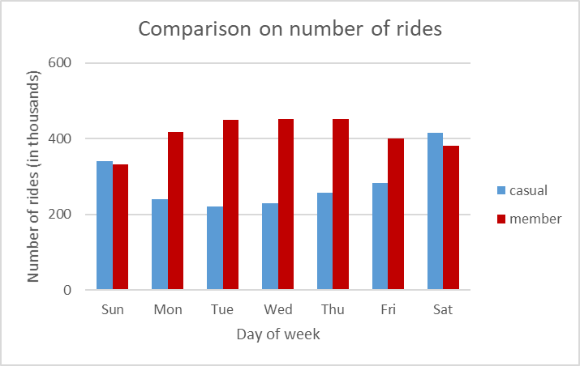
Number of rides
Casual riders are lower on weekdays
Member riders are higher on weekdays
Casual
Member

Slide 11
Recommendations

Slide 12
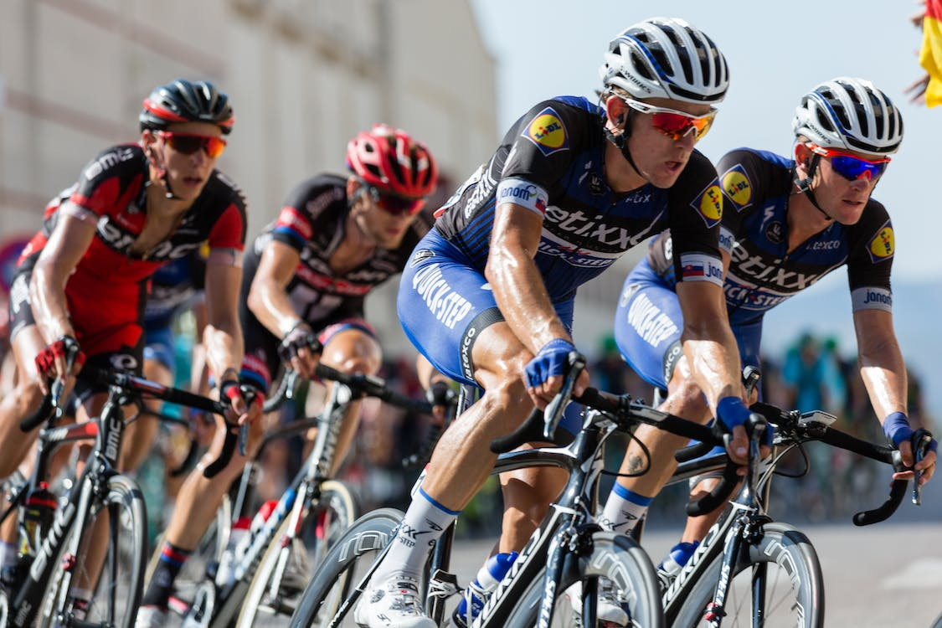
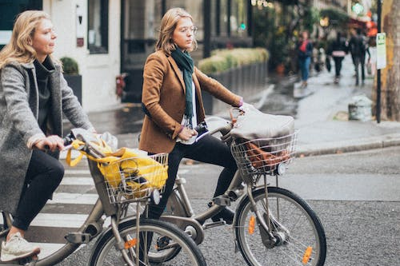
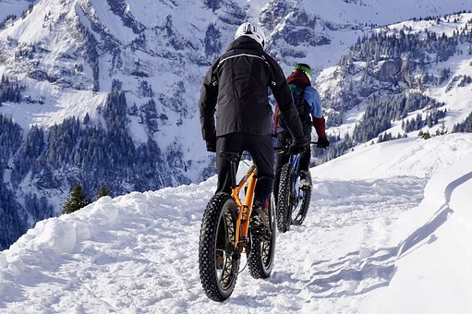
Recommendations
Membership Engagement Track
Cycling in the same track with annual members.
Get Work Member
Annual members get discount 10% for 10 new members.
Expandable Cycling
Cycling in the longer track and time.

Slide 13

“Better to do something, rather than to do nothing”

